Slide 1

Integration of object manipulation within the Navigation Topology BEP
Ismail Elmasry
22 March 2022

Slide 2
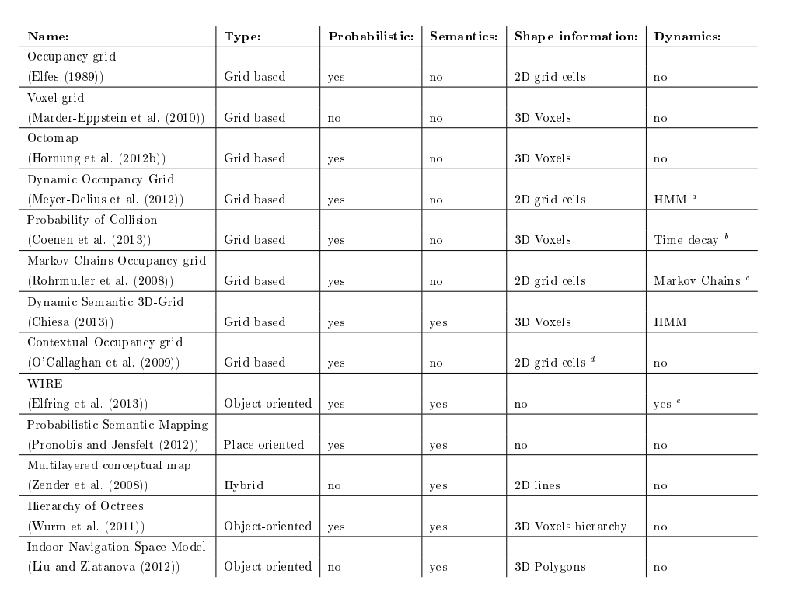
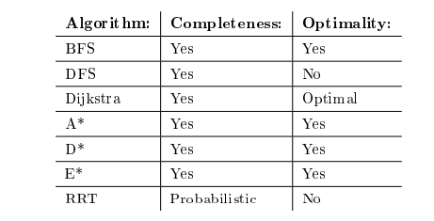
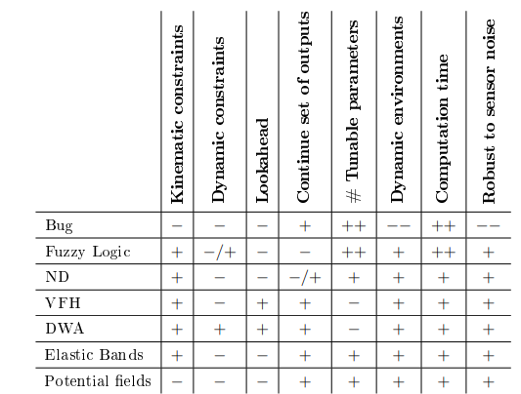
Literature study:
Extensive research on:
World Representations:
Grid Based, data driven representations:
Static
Dynamic
Object-oriented, model-driven representations
Representation planning:
Configuration spaces vs work space?
Generation of connectivity graphs (Roadmaps, Sampling based, cell decomposition)
Potential Fields
Path Planning:
Global and topological planning
Graph search algorithms ( A*, BFS,DFS,Dijkstra’s , D*, E*) and randomized graph searches (RRT)
Local Motion planning :
Bug Algorithm
Fuzzy Logic
VFH
DWA
Elastic Band
Potential fields

Slide 3
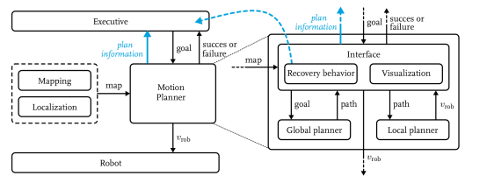
Current Navigation stack
A Hierarchical motion planning system which consists of:
Global Planner: provides connectivity information to the global goal with the use of an A* search algorithm.
Local planner: The steering commands are made using DWA
Executive : A general state machine which provides goals to the motion planner. The recovery behavior is also implemented in this module as it knows more information about the world and the task being executed.

Slide 4
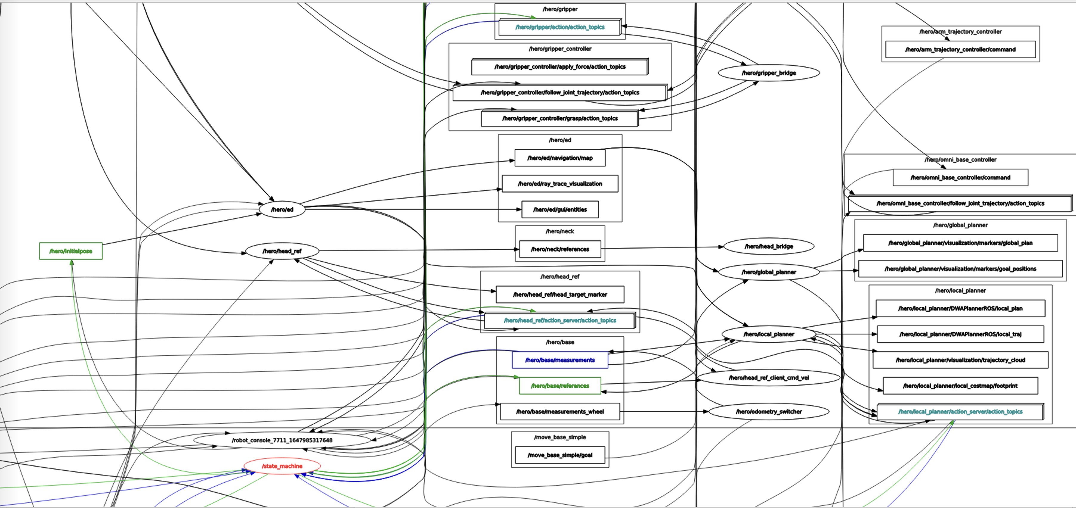
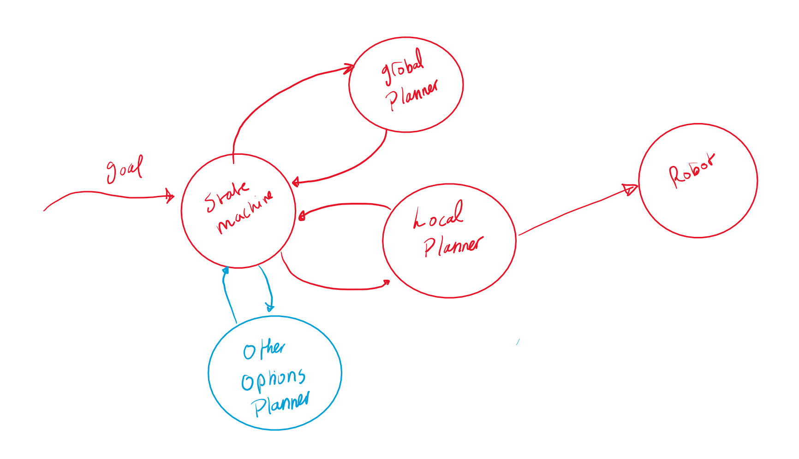
Current ROS architecture
Current ROS architecture simplified:
The extension of the state machine to look
Into other options if the global planner cannot find a
Possible route.
Other options may include:
If there is a door detected open it
If there is an object that is classified as manipulatable
Move it
Etc.

Slide 5
Conceptual approach
Assumptions:
Robot can Drive
Robot can open a door
Robot can manipulate Known objects
Robot can detect and classify doors

Slide 6
Object Classification:
Object Types:
STATIC:
Cannot be repositioned and must always be avoided. Approximate bounding box models can be used to express that.
MOVABLE:
Can be repositioned (chairs, small boxes, doors ,etc.) may require robot manipulation and can be represented internally by 3D mesh models.

Slide 7
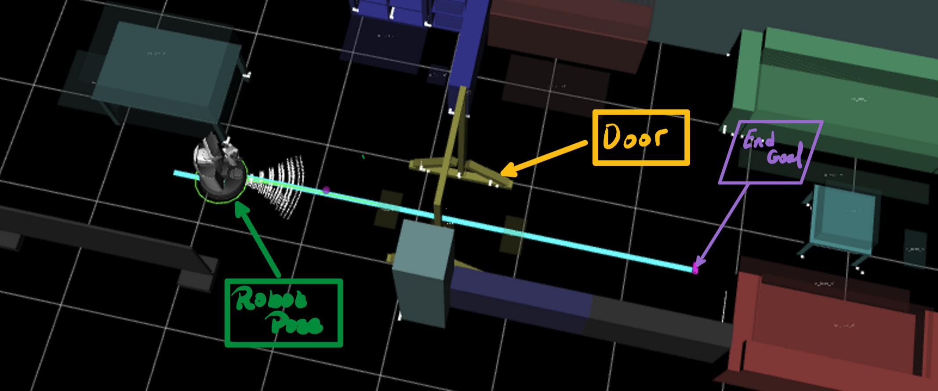
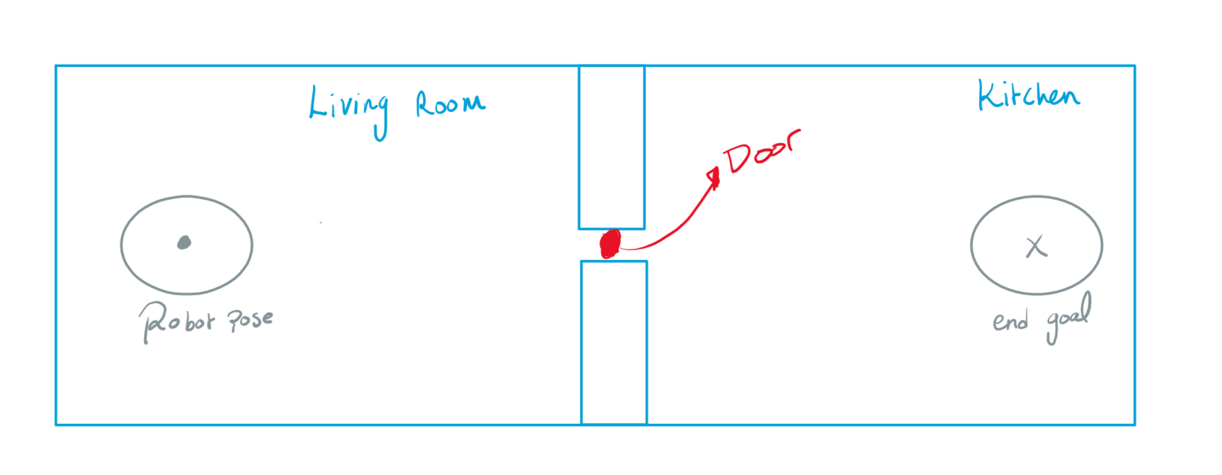
Conceptual approach –Formulating the problem(Door open)

Slide 8
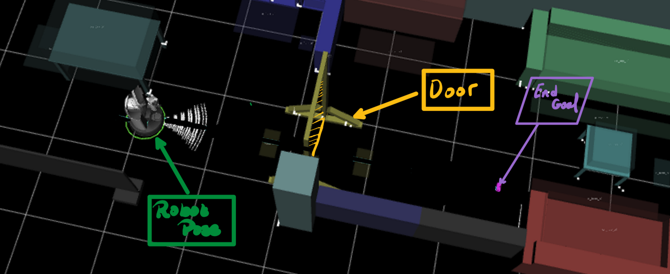
Conceptual approach –Formulating the problem (Door closed)

Slide 9
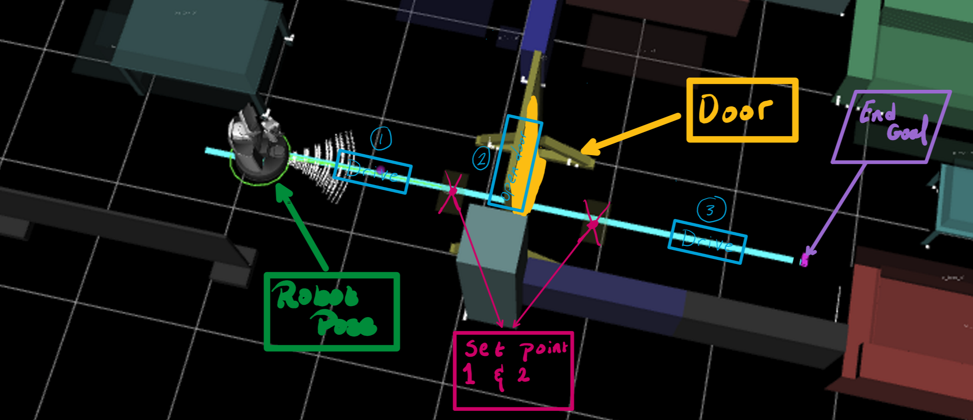
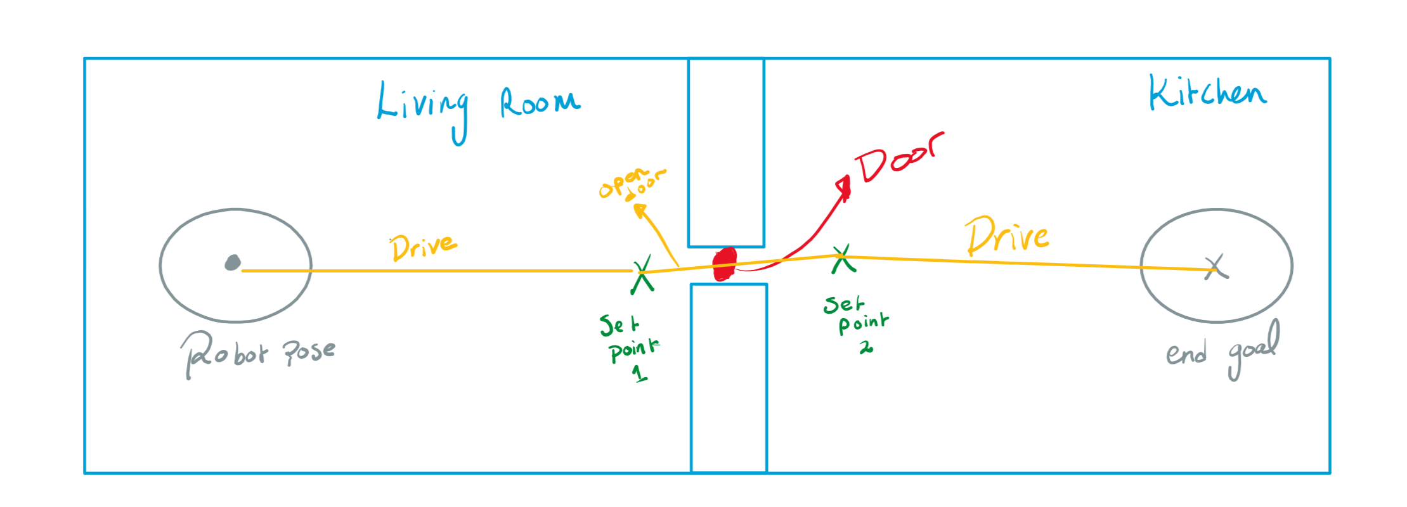
Conceptual approach- Possible solution 1

Slide 10
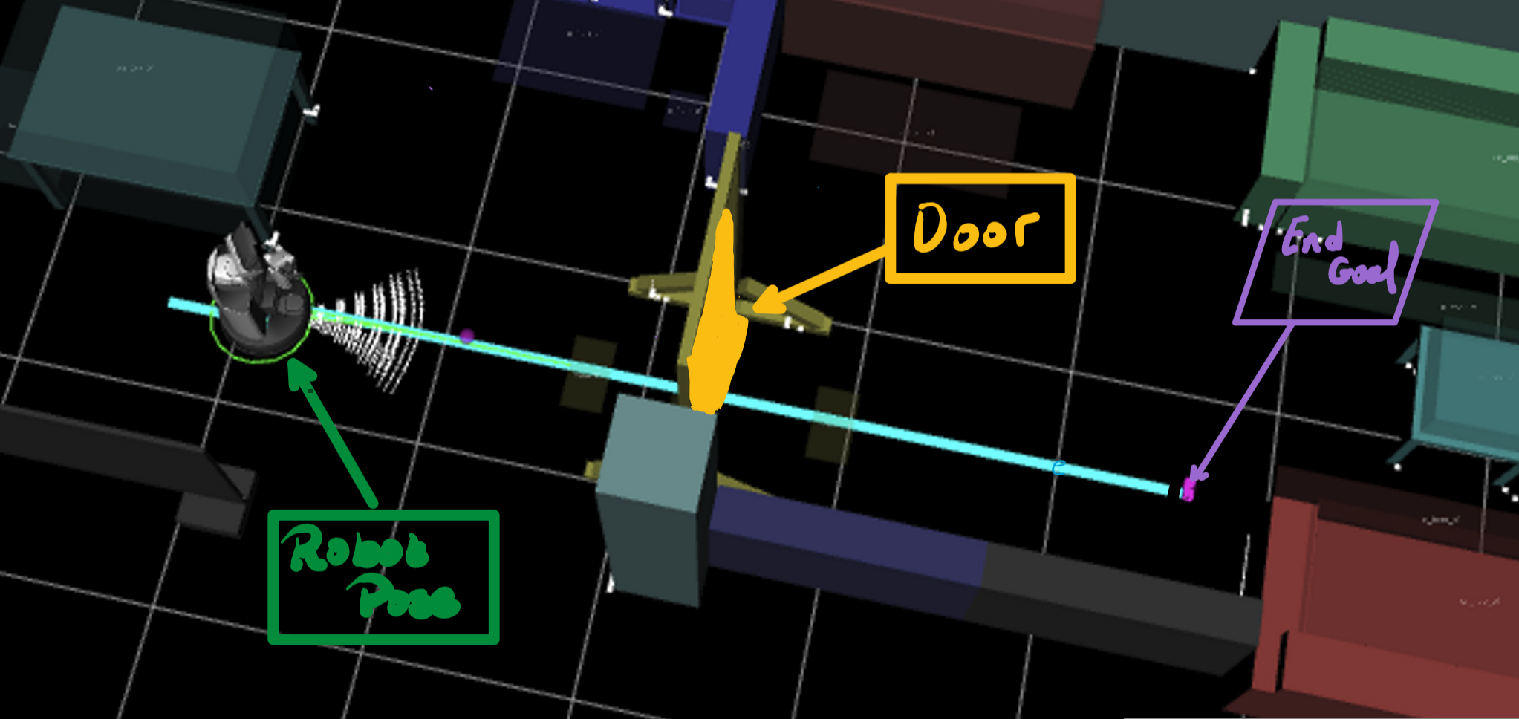

Conceptual approach- Extension and reformulation of concept 1
Given:
the configuration space of the robot $C_{space}$, which defines the configurations of the obstacles in planner space.
The robot pose $R_{1}$.
We then define the robot's free space $C_{free}$ into individual components. Such that, If robot pose $R_{1} is in C_{i}$any other configuration $R_{2}∈C_{i}$can be reached by a standard planner.
The higher-level planner searches for a sequence of configurations on the way to the goal.(grid planner using a heuristic of minimal Euclidian distance and penalized for entering obstacles)
Once the object that can be manipulated is detected the manipulation algorithm overrides.

Slide 11
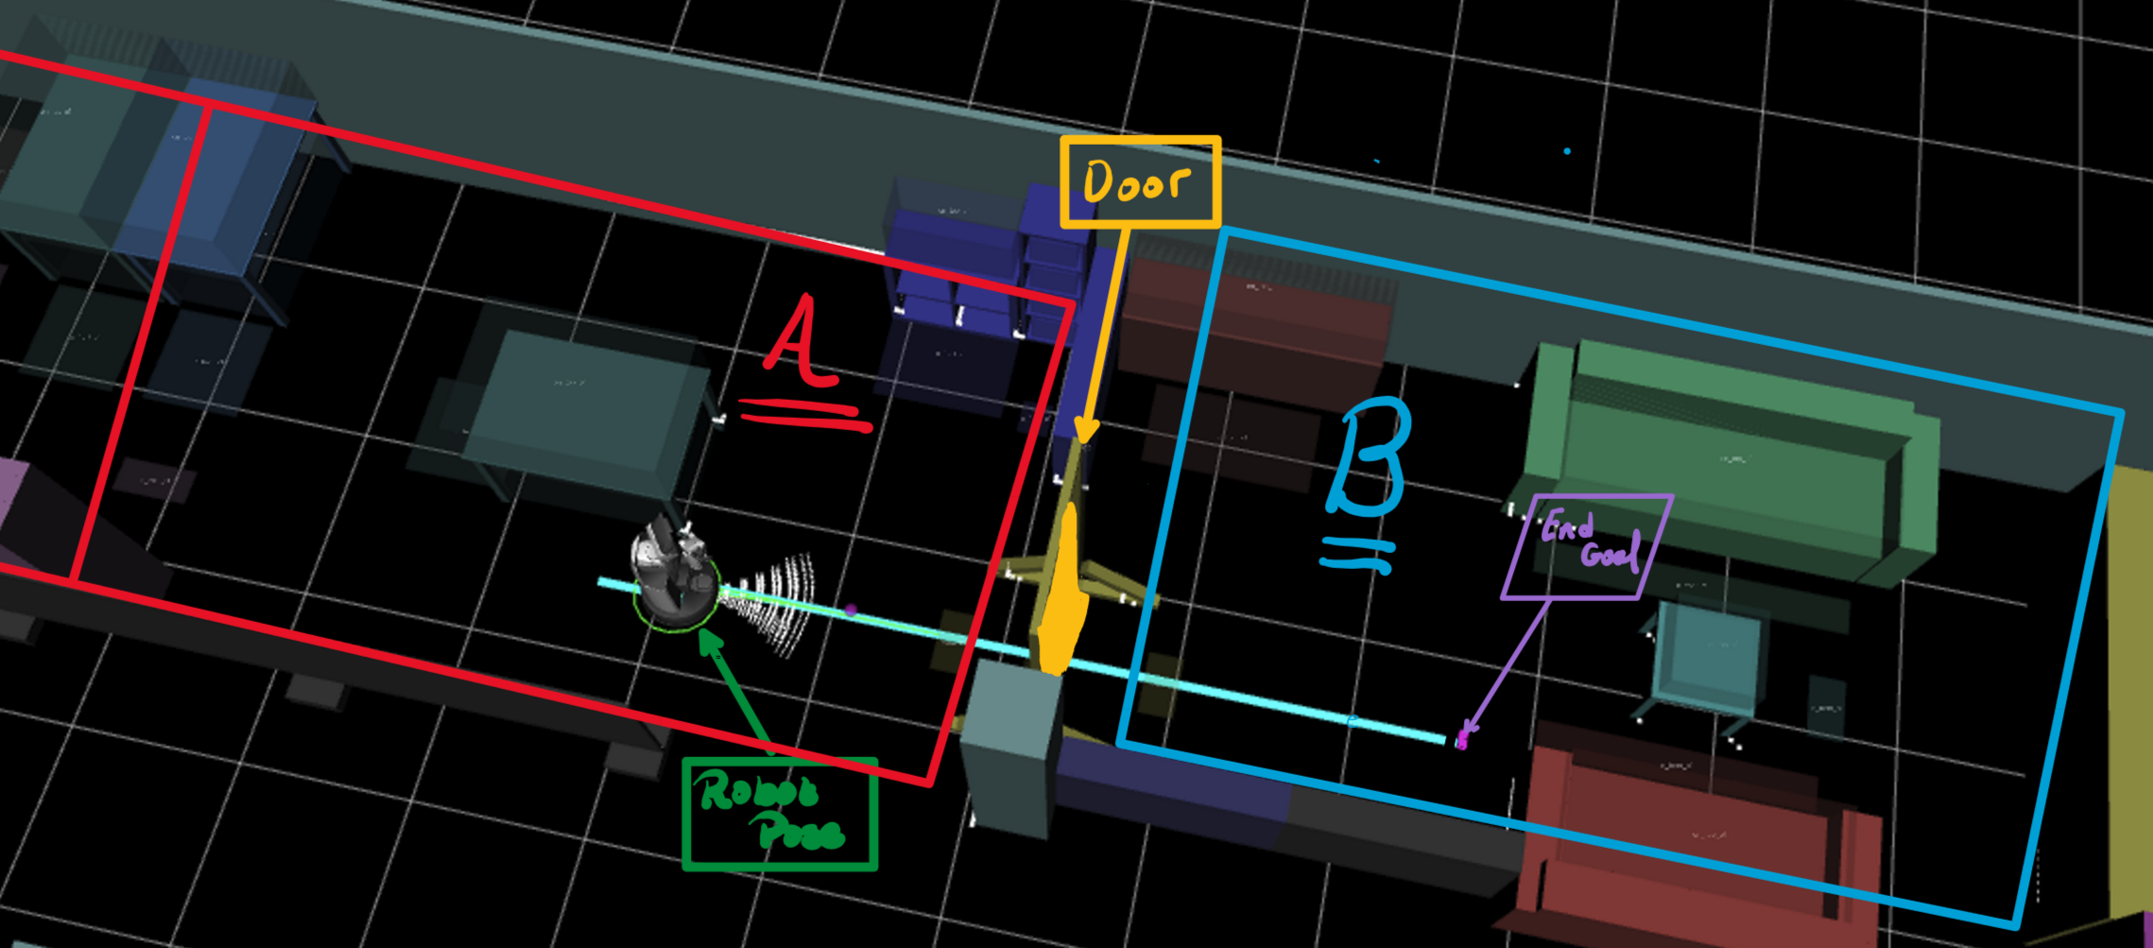

Conceptual approach- Possible solution 2
The robot's free space is implicitly partitioned into subsets $C_{B}=\{C_{1},…,C_{n}\}$ and $C_{A}=\{C_{1},…,C_{m}\}$
If robot pose $R_{1}∈C_{A}$and the Goal $G_{1}∈C_{B}$ , meaning that the robot wants to move from one room to the other than the robot can predict that there will be a door (a manipulable object will be detected)

Slide 12
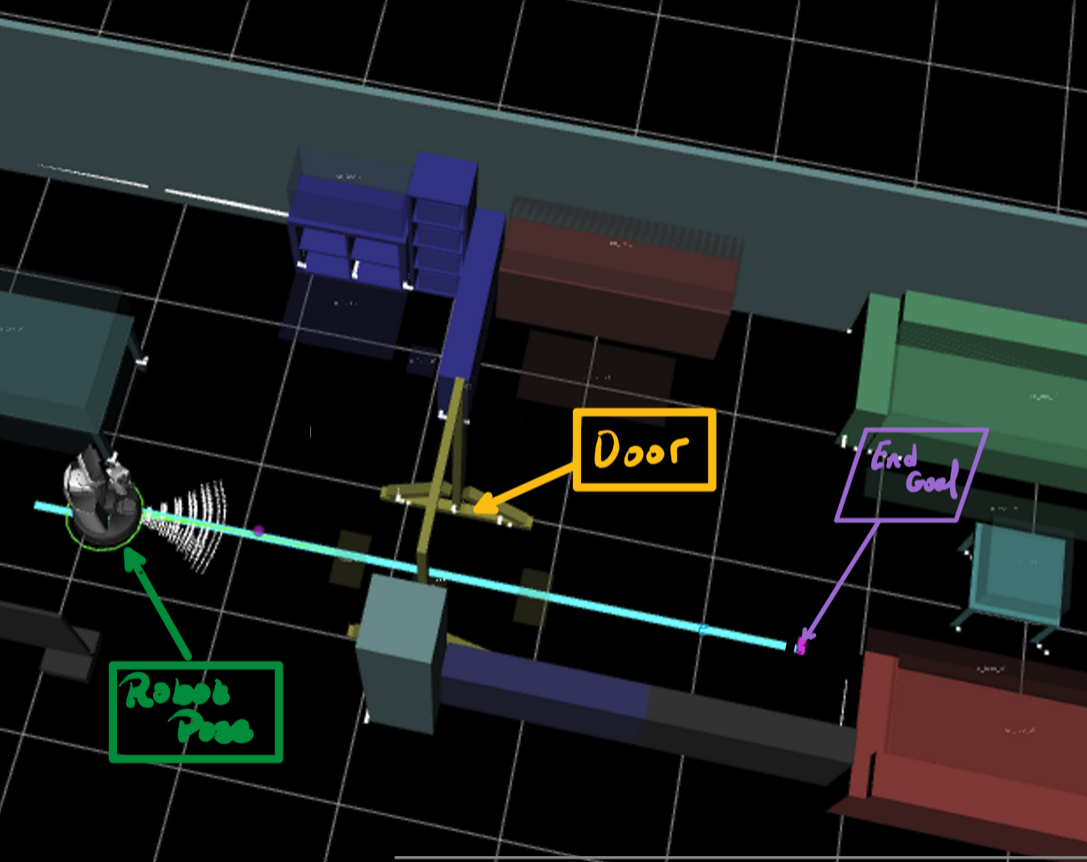
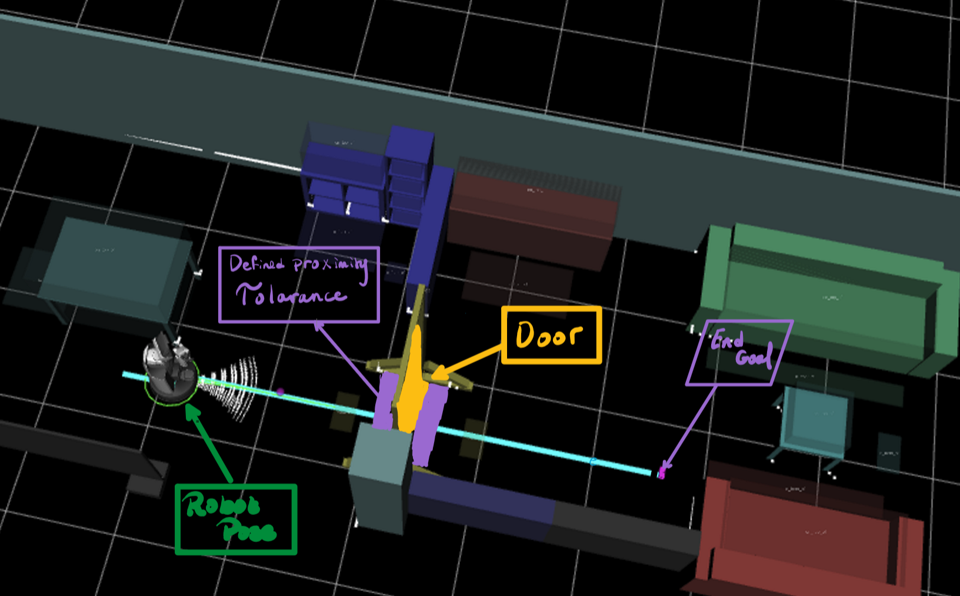
Conceptual approach- Possible solution 3
Applying different map layers:
Global and local planner have different maps:
The global map only sees the map boundaries and static objects.
The local planner map has the dynamic objects also added on top.
if the proximity tolerance region is reached the system checks whether the object detected is dynamic or static and can act accordingly.
a) Global planner map
b) Local planner map

Slide 13
Planning and future steps:
Choose a Conceptual approach or a number of concepts and conduct a comparative analysis.
Attempt to reformulate the configuration space by including dynamic and static object differentiation.
Define the free space subsets of the robot depending on the chosen concept.
Integrate the object manipulation with the navigation plan.
Look into the current technology in hero for opening doors or manipulating small objects.
Test, Test and Test.

